Slide 1
Visual Studio Extensions
A Plugin for Team Foundation Server

Slide 2
Visual Studio Extensions from Microsoft
Online from their Marketplace
Other vendors and developers can contribute their own projects and utilities.
Get updates

Slide 3
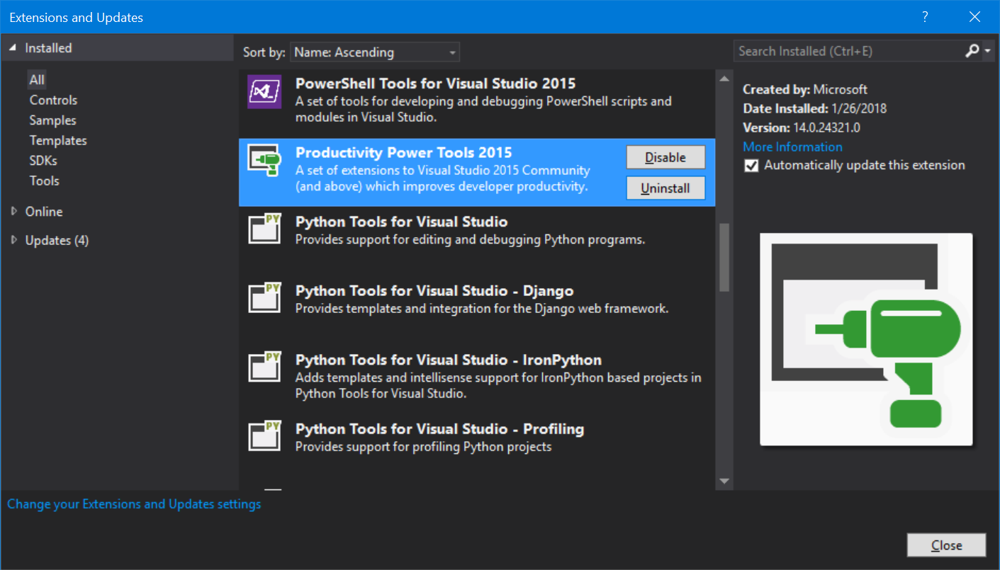
Title and Content Layout with Chart

Slide 4
This presentation is about installing and using the utility. A “how to” create a plugin topic is a more lengthy presentation.
Briefly:
There are several various versions and combination of components required depending up the Visual Studio Target environment, the Team Foundation environment and the version of Visual Studio that you are planning to developing on.
Microsoft has yet a newer process for creation and distribution that I’m hoping will be less cumbersome.

Slide 5
There are many steps to create, debug, test, install, configure and use extensions.
Create
Debug
Reference assemblies
Write code
TEST
fix
build
repeat
Test-there’s a loop here somewhere
Install
Restart VS
Configure
Demonstrate
Check in sample Code
Alerts for new code checked in by another team member
This was fun to build

Slide 6
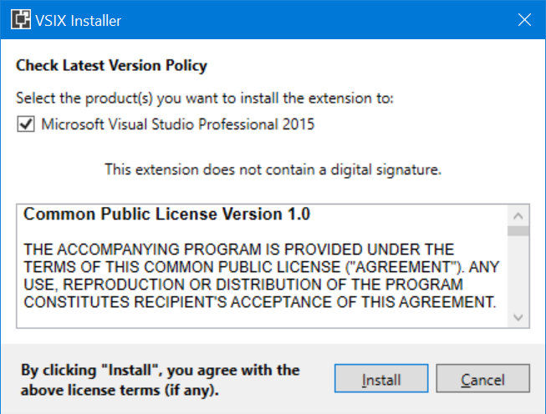
Skip to the Install and Demo! This is a plugin for a team developing the same solution in TFS. This is a “Custom Check in Policy”

Slide 7
If you are trying to coordinate with your team code check-ins, this may help. We always try to “get latest”, but sometimes we have reasons for not synchronizing our code at that time. And of course, we get busy and forget… TFS also has a habit of not refreshing with the new status of someone else’s check in. Start or Restart Visual Studio…

Slide 8
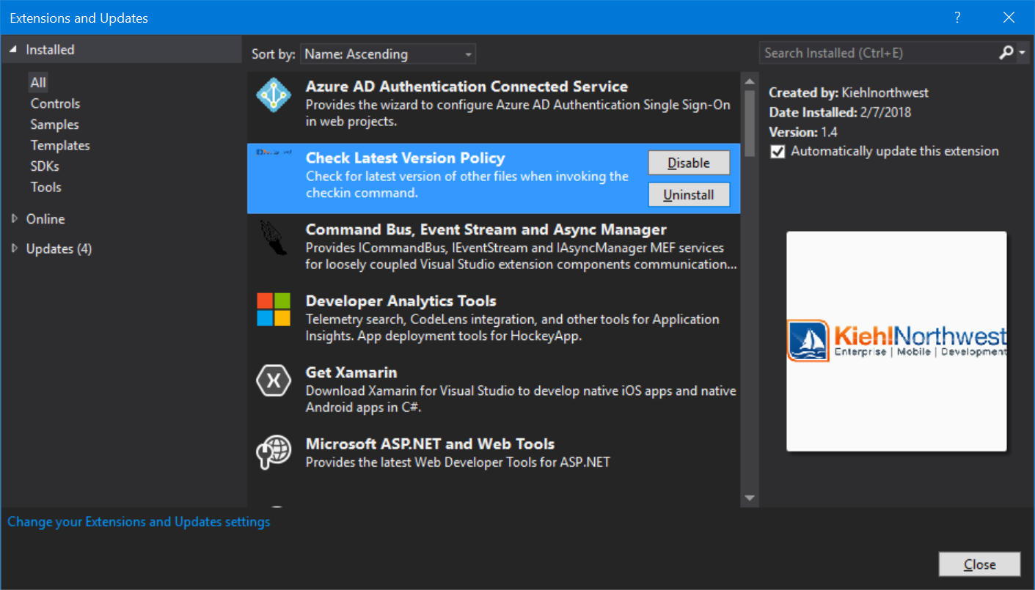
Extension list after install

Slide 9
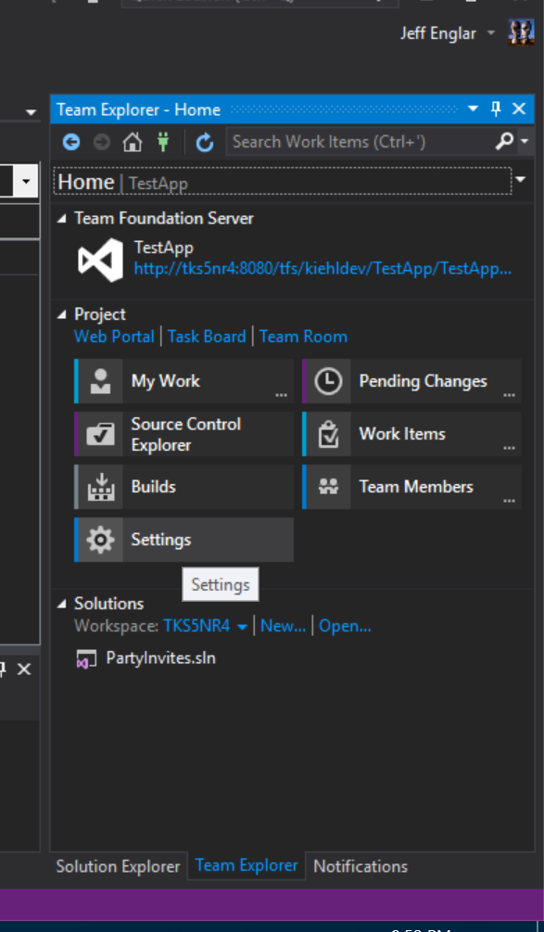
Configuration: Connect to TFS Team Explorer Settings

Slide 10
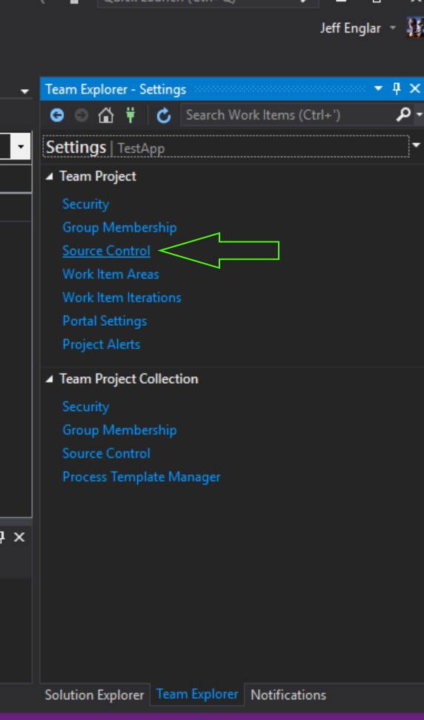
Source Control

Slide 11
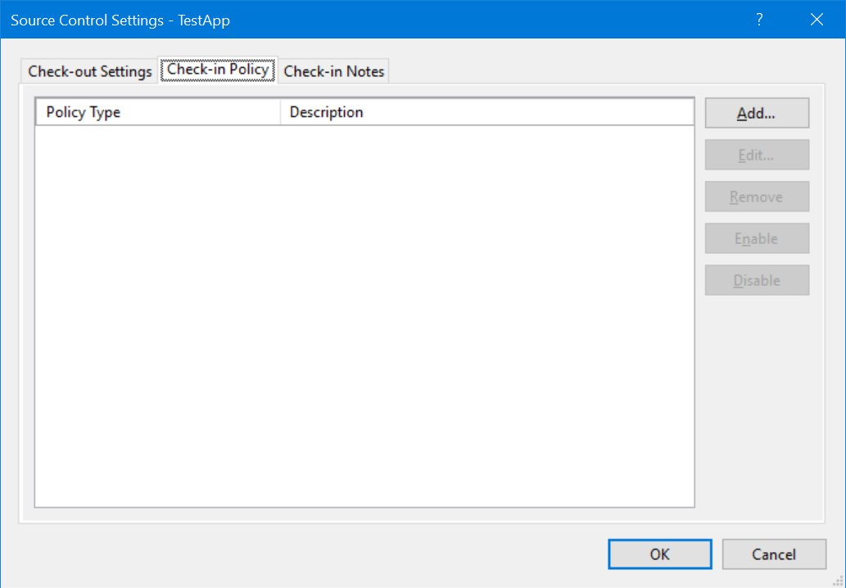
Source Control Settings: Check-in Policy

Slide 12
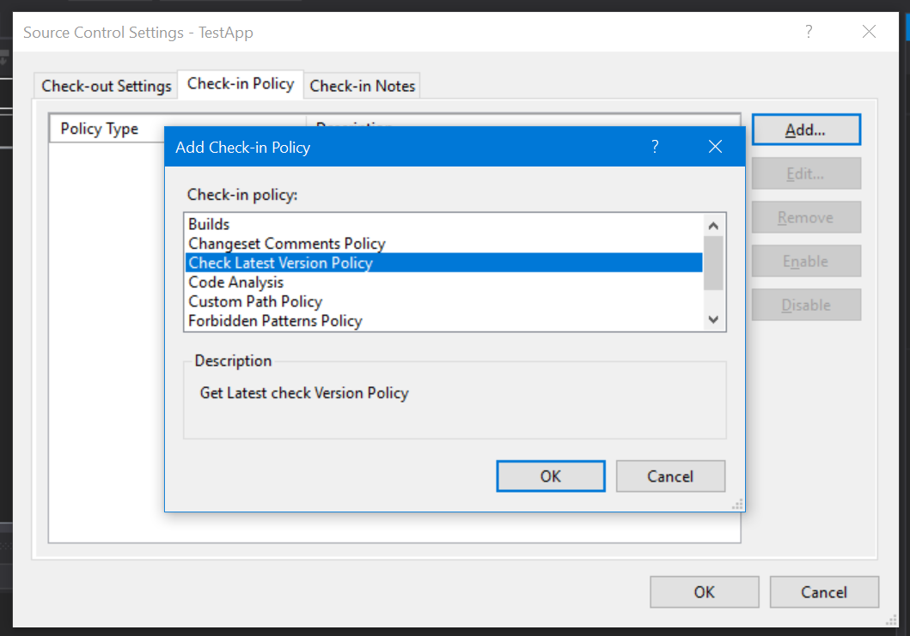
Add the installed Policy

Slide 13
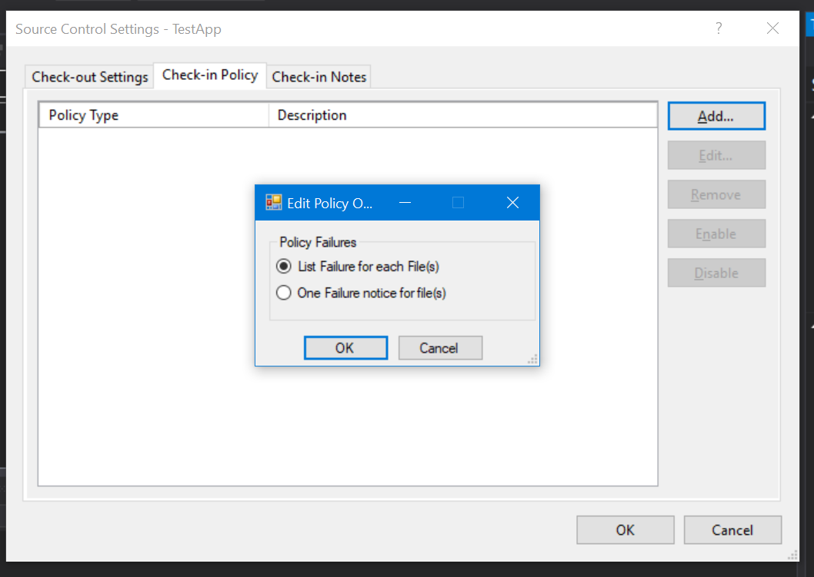
Select if you want to see a list of files that are out of sync or just one simple notice

Slide 14
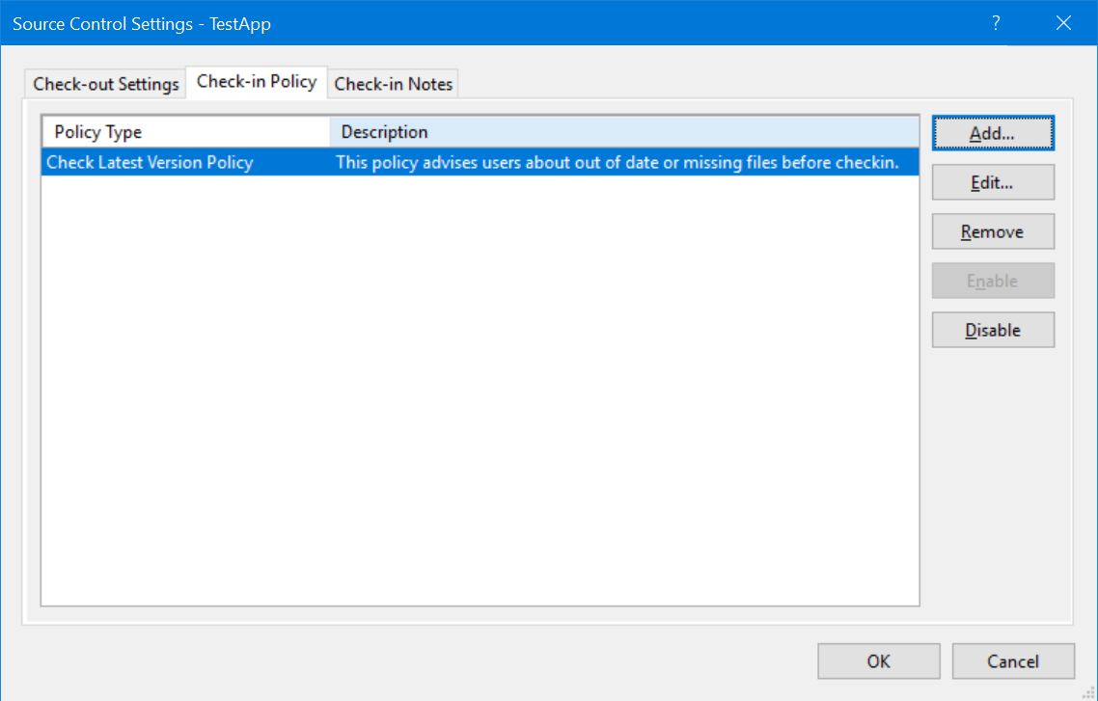
Ready to get some work done

Slide 15
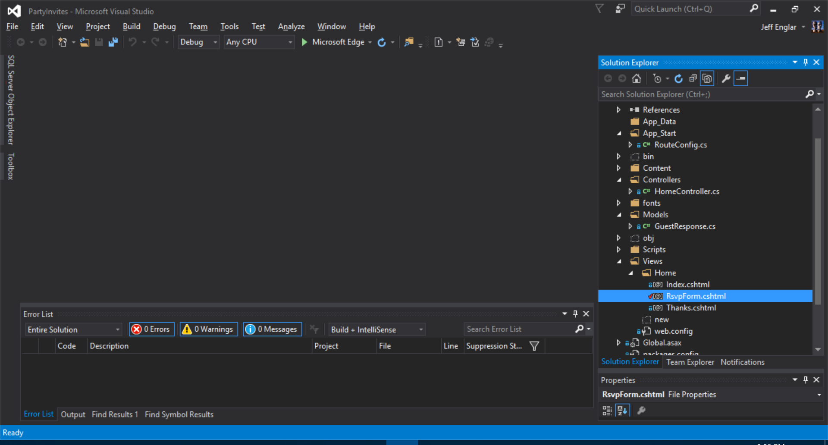
Load project, Check in your code.

Slide 16
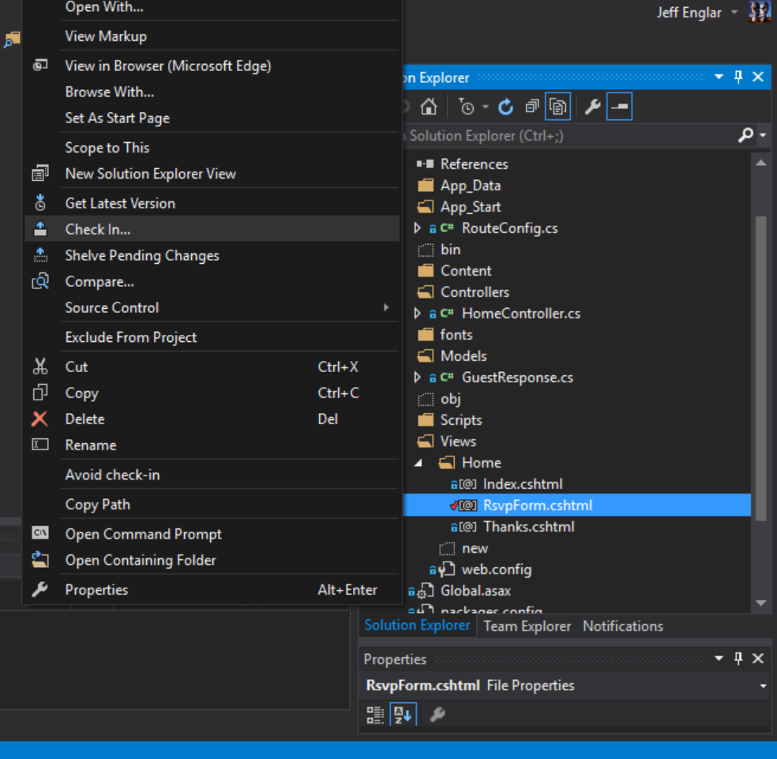
It looks like I have the latest code, I got latest an hour ago and I’m in a hurry… Check it in! they are waiting for a deployment! (I really just want lunch)

Slide 17
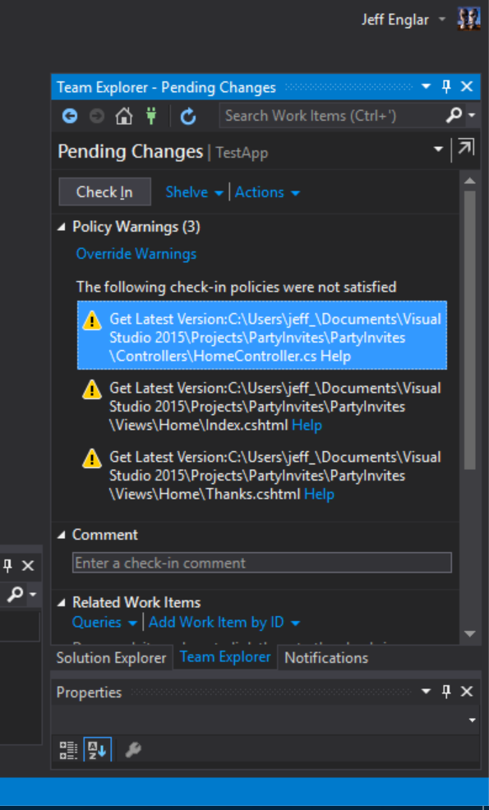
I knew about my cshtml files, I didn’t want to bother with a merge and I know its ok to get them later, but I didn’t know that Johnny just updated the HomeController 2 seconds ago...

Slide 18
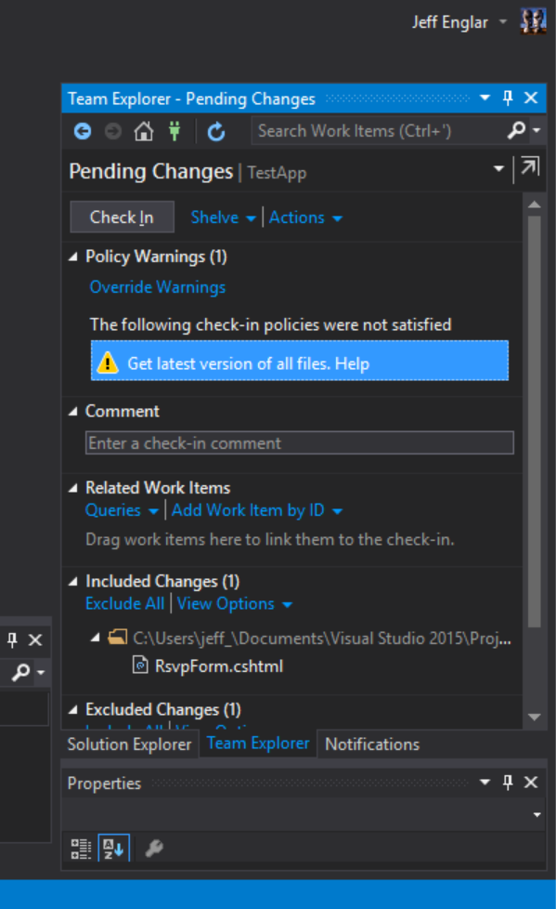
If the file list is too long, or you just want a simple notice, set it to single. You can then do a full compare if necessary or just get latest.

Slide 19
Questions? Demo?

